Slide 1
Med Tracker
Iteration 2
CS 673 Team 1:
Andrew Gieraltowski, Divya Thomas, Yuan Wang, Haiyang Lu

Slide 2
Our Product
Med Tracker:
Track and manage medications
Intuitive design for elderly people

Slide 3
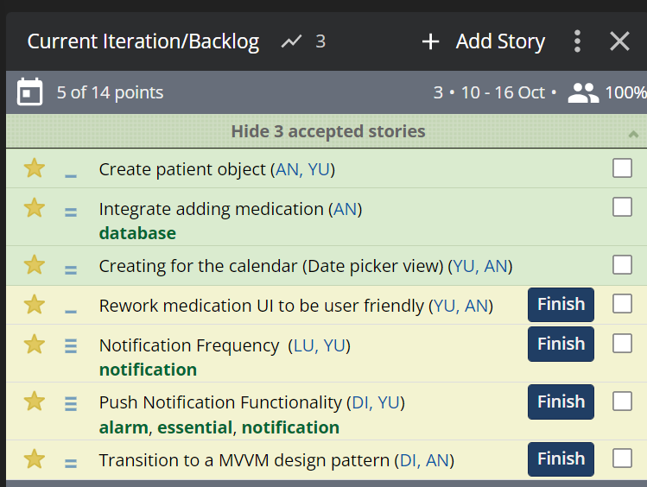
Iteration 2

Slide 4
Deliverables
Database localization and refactoring
Created a strategy pattern for frequency objects
Automated update date time logic
Notification configuration list of dialogs
date/time picker configuration on UI
UI error handling/dialogs
Unit Testing for the UI

Slide 5
How we approach deliverables
Pivot the goal from iteration 1
Research on websites about Android functionalities
Discuss code on discord
Code review by team members

Slide 6
Future Plans
Continue work on error handling, UI/database communication, and medication display
Continue work on the UI unit testing
Integrate a MVVM architecture to aid in UI/database communication, and database unit testing

Slide 7
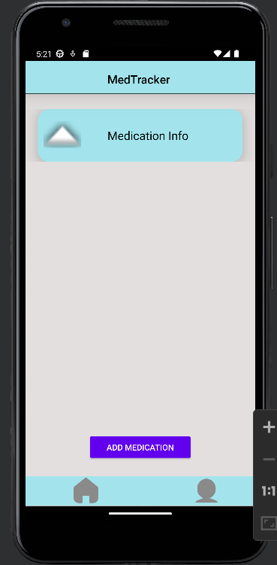
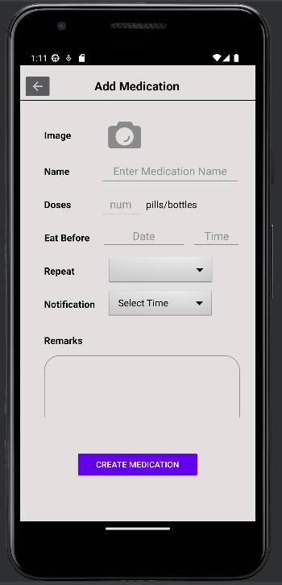
Demo

